Slide 1
Data Structures and Algorithm Analysis
Graphs and BFS II
Lecture 14:
Department of Computer Science & Technology Beijing Normal – Hong Kong Baptist University

Slide 2
Shortest Path Recording
BFS we saw only tells us whether a path exists from source s, to other vertices v.
It doesn’t tell us the path!
We need to modify the algorithm to record the path
How can we do that?
Note: we do not know which vertices lie on this path until we reach v!
Efficient solution:
Use an additional array pred[0..n-1]
Pred[w] = v means that vertex w was visited from v

Slide 3
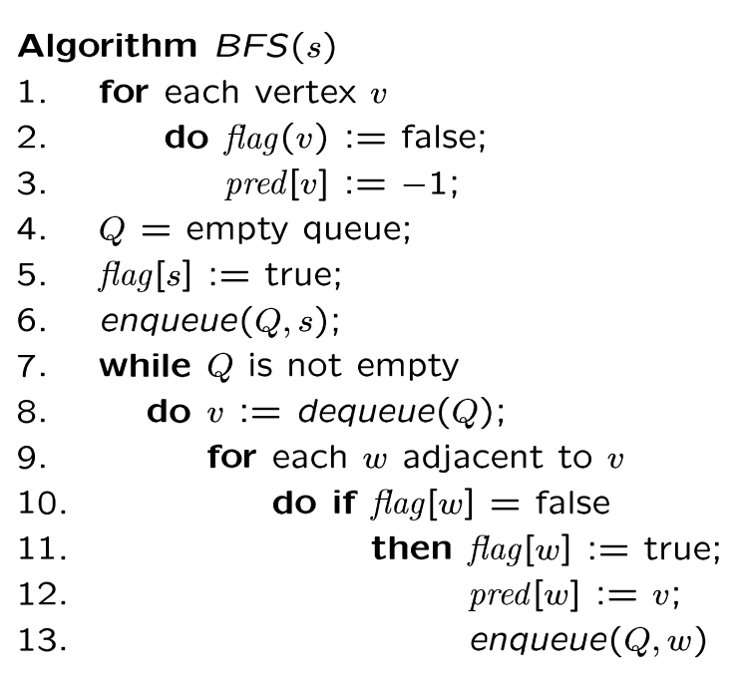
BFS + Path Finding
initialize all pred[v] to -1
Record where you came from

Slide 4
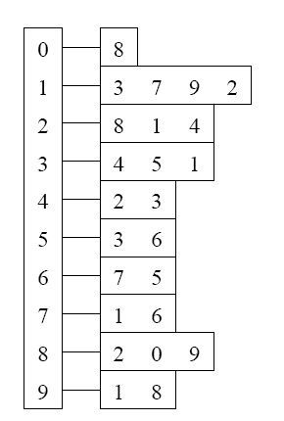
Example
Visited Table (T/F)
Adjacency List
0
0
1
2
3
4
5
6
7
8
9
F
F
F
F
F
F
F
F
F
F
-
-
-
-
-
-
-
-
-
-
8
source
2
9
1
3
7
6
4
5
Pred
Initialize visited
table (all False)
Initialize Pred to -1
Q = { }
Initialize Q to be empty

Slide 5
Example (Cont’d)
Adjacency List
Visited Table (T/F)
0
0
1
2
3
4
5
6
7
8
9
F
F
T
F
F
F
F
F
F
F
-
-
-
-
-
-
-
-
-
-
8
source
2
9
1
3
7
6
4
5
Pred
Flag that 2 has
been visited.
Q = { 2 }
Place source 2 on the queue.

Slide 6
Example (Cont’d)
Adjacency List
Visited Table (T/F)
0
0
1
2
3
4
5
6
7
8
9
F
T
T
F
T
F
F
F
T
F
-
2
-
-
2
-
-
-
2
-
8
Neighbors
source
2
9
1
3
7
6
4
5
Pred
Mark neighbors
as visited.
Record in Pred
that we came from 2.
Q = { 2 } → { 8, 1, 4 }
Dequeue 2.
Place all unvisited neighbors of 2 on the queue

Slide 7
Example (Cont’d)
Adjacency List
Visited Table (T/F)
0
0
1
2
3
4
5
6
7
8
9
T
T
T
F
T
F
F
F
T
T
8
2
-
-
2
-
-
-
2
8
8
source
2
9
1
3
7
6
Neighbors
4
5
Pred
Q = { 8, 1, 4 } → { 1, 4, 0, 9 }
Mark new visited
neighbors.
Record in Pred
that we came from 8.
Dequeue 8.
Place all unvisited neighbors of 8 on the queue.
Notice that 2 is not placed on the queue again, it has been visited!

Slide 8
Adjacency List
Visited Table (T/F)
0
0
1
2
3
4
5
6
7
8
9
T
T
T
T
T
F
F
T
T
T
8
2
-
1
2
-
-
1
2
8
Neighbors
8
source
2
9
1
3
7
6
4
5
Pred
Mark new visited
neighbors.
Record in Pred
that we came from 1.
Q = { 1, 4, 0, 9 } → { 4, 0, 9, 3, 7 }
Dequeue 1.
Place all unvisited neighbors of 1 on the queue.
Only nodes 3 and 7 haven’t been visited yet.

Slide 9
Example (Cont’d)
Adjacency List
Visited Table (T/F)
0
0
1
2
3
4
5
6
7
8
9
T
T
T
T
T
F
F
T
T
T
8
2
-
1
2
-
-
1
2
8
8
source
2
9
Neighbors
1
3
7
6
4
5
Pred
Q = { 4, 0, 9, 3, 7 } → { 0, 9, 3, 7 }
Dequeue 4.
4 has no unvisited neighbors!

Slide 10
Example (Cont’d)
Adjacency List
Visited Table (T/F)
0
0
1
2
3
4
5
6
7
8
9
T
T
T
T
T
F
F
T
T
T
8
2
-
1
2
-
-
1
2
8
Neighbors
8
source
2
9
1
3
7
6
4
5
Pred
Q = { 0, 9, 3, 7 } → { 9, 3, 7 }
Dequeue 0.
0 has no unvisited neighbors!

Slide 11
Example (Cont’d)
Adjacency List
Visited Table (T/F)
0
0
1
2
3
4
5
6
7
8
9
T
T
T
T
T
F
F
T
T
T
8
2
-
1
2
-
-
1
2
8
8
source
2
9
1
3
7
6
4
5
Neighbors
Pred
Q = { 9, 3, 7 } → { 3, 7 }
Dequeue 9.
9 has no unvisited neighbors!

Slide 12
Example (Cont’d)
Adjacency List
Visited Table (T/F)
0
0
1
2
3
4
5
6
7
8
9
T
T
T
T
T
T
F
T
T
T
8
2
-
1
2
3
-
1
2
8
8
source
2
Neighbors
9
1
3
7
6
4
5
Pred
Mark new visited
vertex 5.
Record in Pred
that we came from 3.
Q = { 3, 7 } → { 7, 5 }
Dequeue 3.
place neighbor 5 on the queue.

Slide 13
Example (Cont’d)
Adjacency List
Visited Table (T/F)
0
1
2
3
4
5
6
7
8
9
T
T
T
T
T
T
T
T
T
T
8
2
-
1
2
3
7
1
2
8
0
8
source
2
9
1
3
7
Neighbors
6
4
5
Pred
Mark new visited
vertex 6.
Record in Pred
that we came from 7.
Q = { 7, 5 } → { 5, 6 }
Dequeue 7.
place neighbor 6 on the queue.

Slide 14
Example (Cont’d)
Adjacency List
Visited Table (T/F)
0
0
1
2
3
4
5
6
7
8
9
T
T
T
T
T
T
T
T
T
T
8
2
-
1
2
3
7
1
2
8
8
source
2
9
1
Neighbors
3
7
6
4
5
Pred
Q = { 5, 6} → { 6 }
Dequeue 5.
no unvisited neighbors of 5.

Slide 15
Example (Cont’d)
Adjacency List
Visited Table (T/F)
0
0
1
2
3
4
5
6
7
8
9
T
T
T
T
T
T
T
T
T
T
8
2
-
1
2
3
7
1
2
8
8
source
2
9
1
3
7
Neighbors
6
4
5
Pred
Q = { 6 } → { }
Dequeue 6.
no unvisited neighbors of 6.

Slide 16
BFS Finished
Adjacency List
Visited Table (T/F)
0
0
1
2
3
4
5
6
7
8
9
T
T
T
T
T
T
T
T
T
T
8
2
-
1
2
3
7
1
2
8
8
source
2
9
1
3
7
6
4
5
Pred
Pred now can be traced backward
to report the path!
Q = { }
STOP!!! Q is empty!!!

Slide 17
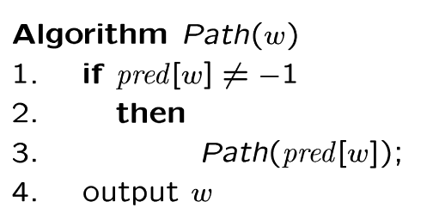
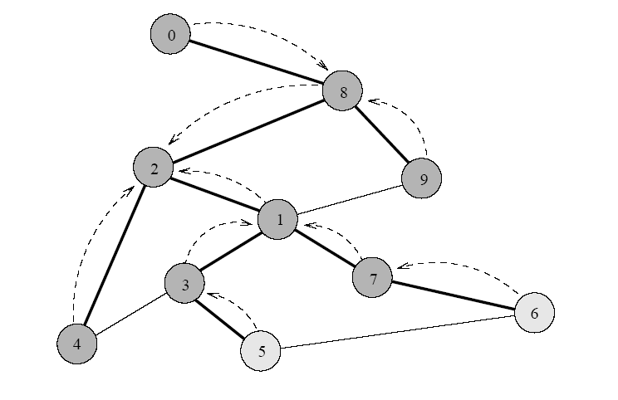
Path Reporting
nodes
visited from
0
1
2
3
4
5
6
7
8
9
8
2
-
1
2
3
7
1
2
8
Recursive algorithm
Try some examples, report path from s to v:
Path(0) ->
Path(6) ->
Path(1) ->
The path returned is the shortest from s to v (minimum number of edges).

Slide 18
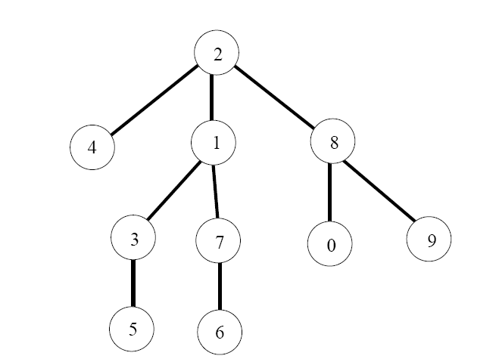
BFS Tree
The paths found by BFS is often drawn as a rooted tree (called BFS tree), with the starting vertex as the root of the tree.
BFS tree for vertex s = 2
Question: What would a “level” order traversal tell you?

Slide 19
Record the Shortest Distance
d(v) = ∞;
d(s) = 0;
d(w)=d(v)+1;

Slide 20
Application of BFS
One application concerns how to find connected components in a graph
If a graph has more than one connected components, BFS builds a BFS-forest (not just BFS-tree)!
Each tree in the forest is a connected component.

